Slide 1
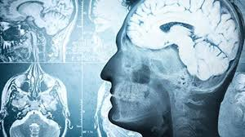
Alzheimer’s Disease: Research Opportunities for ALL
Sheila Baez-Torres, MD, MBA

Slide 2
What is Dementia?
Loss of function including:
- Recalling information
- Understanding language
- Not finding words
- Getting lost
- Confusion
- Changes in personality
- Forgetting how to do simple tasks

Slide 3
What Are the Risk Factors for Dementia?
Age (older than 65 y/o)
Diabetes Mellitus type 2
High Blood Pressure
High Cholesterol
Sedentary life (physical, cognitive)
Family History
Genetic Makeup (APOE genes)

Slide 4
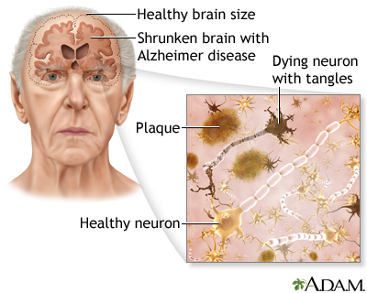
Alzheimer’s Disease: The Most Common Type of Dementia
50-75% of all dementia cases
6th leading cause of death in the United States
By 2020: 6M of AD cases in US
By 2050: 12.7M cases expected
Progressive disease

Slide 5
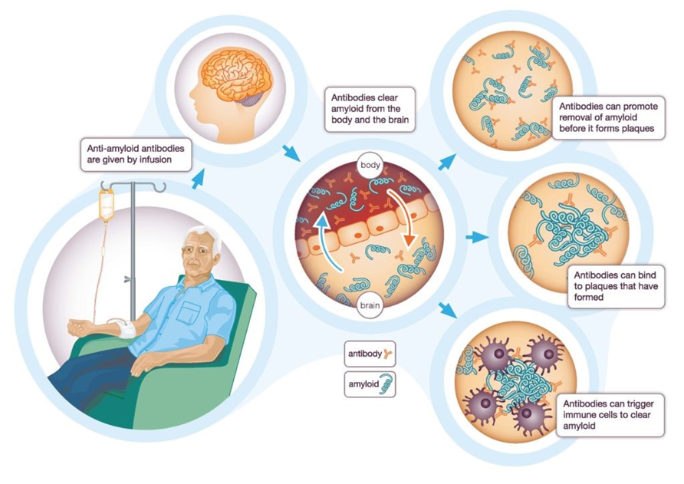
What is New in Alzheimer’s Disease Research?
Protein Amyloid and P-Tau (Found 10-20 years before symptoms start)
We can find these proteins in blood
Monoclonal antibodies may help immune cells learn to target and remove these proteins

Slide 6
FDA APPROVED DISEASE-MODIFYING TREATMENTS
2021
Aducanumab (Aduhelm): Biogen
2023
Lecanemab (Leqembi):
Biogen & Eisai

Slide 7
CAN WE SCREEN FOR AD & TREAT IT BEFORE SYMPTOMS START?

Slide 8
ALZHEIMER’S DISEASE PREVENTION STUDIES
Early Detection
(Pre-symptom Stage)
Early Treatment (Slow Its Progression)
Studies are Available now!!
Goal:
Alzheimer’s Who??

Slide 9
Your AD Risk Profile: What To Screen For
Amyloid Protein
P-Tau Protein
APOE genotype
Baseline Memory Test
Re-screen for Amyloid and P-Tau proteins and memory testing yearly or every 2 years.

Slide 10
Alzheimer’s and Minorities
AFR0-AMERICANS
HISPANICS
2x higher risk for AD than Caucasians
1.5x higher risk than Caucasians

Slide 11
US-FDA: Clinical Trials Conducted in USA (2015-2019)
By Race:
- 80% white
- 16% black and/or AA
- 6 % other races
By Ethnicity:
- 76% Non-Hispanic
- 15% Hispanics and/or Latin Americans
- 9% Not reported

Slide 12
Why Minorities Are Important in Clinical Research
We all have different genetic make up
We need to understand how the medical conditions and treatment affect certain groups
To learn what populations could be at higher risk
To develop effective and safe treatments for all
To make sure that more people have access to the best treatment possible

Slide 13
Possible Barriers
Lack of awareness about what clinical research is
Fear to be a “guinea pig”
Language barriers
Cultural shyness
Transportation limitations

Slide 14
Our Goals
To build trust
To share the information available
To break barriers
To offer early detection and treatment

Slide 15
WHAT ARE WE DOING TO HELP
Free evaluation and treatment
Close medical supervision
Educating patients and caregivers
Bilingual staff
Transparency
Health fairs with mobile units

Slide 16
Where Can I Get A Memory Screening Test?
Doctor’s Office
Health Fairs
Clinical Research Sites
Mobile Memory Screening Units

Slide 17
Conclusion
Our goal is to reach out to all groups, and become inclusive
Better understanding of medical conditions, and more treatment options
Better treatment available = better outcome, if the need comes

Slide 18
Conclusion
Education
Early Detection
Healthy Brains For ALL

Slide 19
Enfermedad de Alzheimer: Oportunidades de Investigacion Clinica Para TODOS
Sheila Baez-Torres, MD, MBA

Slide 20
QUE ES DEMENCIA?
Perdida de Funciones del Pensamiento:
- Recordar informacion
- Comunicarse y entender
- No encontrar palabras
- Perderse
- Confusion
- Cambios en personalidad
- Olvidar simples tareas

Slide 21
Factores de Riesgo Para Demencia
Edad (65 y/o mayores)
Diabetes Mellitus tipo 2
Presion Sanguinea Elevada
Colesterol Alto
Vida Sedentaria (fisica y mental)
Historial Familiar
Genetica (Genes APOE)

Slide 22
Enfermedad de Alzheimer: La Demencia Mas Comun
Enfermedad Progresiva
50-75% de todos los casos de demencia
6^{ta} causa de muerte en Estados Unidos
En 2020 en EU: 6M de casos
En Florida: 850,000 casos
En 2050: 12.7M posibles casos

Slide 23
Que Hay de Nuevo en la Investigacion de Enfermedad de Alzheimer?
Proteinas amiloide y P-Tau se acumulan 10-20 aňos antes del comienzo de los sintomas
Deteccion de proteinas en la sangre
Anticuerpos monoclonales pueden ayudar a remover estas proteinas

Slide 24
Nuevas Medicinas Aprobadas por FDA:
2021
Aducanumab (Aduhelm): Biogen
2023
Lecanemab (Leqembi): Biogen & Eisai

Slide 25
Mecanismos Bajo Investigacion Clinica:
Anticuerpos Monoclonales Anti-Amiloide
Anticuerpos Monoclonales Anti-Tau
Inhibidores de la Formacion de Amiloide
Anti-Inflamatorios
Terapia Genetica: APOE 4/4 ---> APOE 2/4

Slide 26
Perfil de Riesgo para EA
Proteina Amiloide
Proteina Tau
Gene APOE
Prueba de Memoria
Re-Evaluar de Amiloide and Tau

Slide 27
Alzheimer en las Minorias
AFR0-AMERICANOS
HISPANOS
2x mayor riesgo de Alzheimer que los Caucasicos
1.5x mayor riesgo de Alzheimer que los Caucasicos

Slide 28
Reporte de Estudios Clinicos en EU 2015-2019 (Administracion de Drogas y Alimentos)
Por Raza:
- 80% blancos
- 16% negros y/o AA
- 6 % otras razas
Por Etnicidad:
- 76% NO-Hispanos
- 15% Hispanos
- 9% No reportado

Slide 29
Importancia de las Minorias en Investigacion Clinica
Todos tenemos genes diferentes
Tratamientos specificos para cada grupo etnico
Identificar los grupos en alto riesgo
Desarrollar tratamientos mas seguros y efectivos
Acceso al mejor tratamiento disponible

Slide 30
Posibles Barreras
Falta de conocimiento sobre los beneficios de la investigacion clinica
Miedo a ser “conejillo de India”
Barreras de lenguaje
Creencias culturales
Transportacion

Slide 31
Metas de K2 Medical Research:
Ganar su confianza
Educar a la comunidad
Ofrecer deteccion y tratamiento temprano

Slide 32
EN K2 MEDICAL RESEARCH:
Hablamos ESPANOL
Pruebas de memoria GRATIS
Tratamiento es GRATIS
Transportacion GRATIS

Slide 33
Conclusion
Nuestra meta: Acercarnos a todos los grupos etnicos, y comunidades de Florida Central
Entender mejor las condiciones medicas, y desarrollar mejores tratamientos
Mejores tratamientos = Mejor resultados, si la necesidad surge

Slide 34
Conclusion
Educacion
Deteccion Temprana
Cerebros Saludables para TODOS

