Slide 1
Understanding Alzheimer's
Presented by:
Dr. Stephen Quaning
Notes:
Before we start- I’m going to ask you to close your eyes and raise your hand If you know someone that is currently struggling with some type of Dementia. Open your eyes and look around the room- The Alzheimer’s Association reported in 2021 that in the US 1 out 9 people currently suffered from AD. This means that in 2021 over 6million people have been diagnosed with AD and they are projecting that in 2050 this number will double to over 12 million people only in the USA. Which brings us here, to raise awareness of this disease process and educate you on sings and symptoms as well as current treatment options.

Slide 2
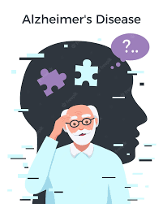
Memory loss and Aging
Is this Normal?
Is this Normal ?
Not remembering the names of close friends and relatives
Trouble verbalizing thoughts
Frequent confusion and inability to focus
Becoming lost in familiar places
Frequent mood changes
Regularly repeating statements or questions
Occasional trouble recalling people or places
Forgetting appointments or events occasionally
Taking longer to process information
Sometimes loosing track of a conversation
Occasionally forgetting where an item is
Notes:
Just like the rest of our bodies, our brains change as we age. Most of us eventually notice some slowed thinking and occasions when we can’t remember certain things. However, serious memory loss, confusion and other major changes may be a sign that brain cells are failing.
I want everyone to understand that Alzheimer’s Disease is not a normal part of aging, however, increase age is the biggest risk factor with Alzheimer’s Disease. Listed here are some examples of normal and not normal sings of memory loss. The key here as you can see is “Ocassionally”

Slide 3
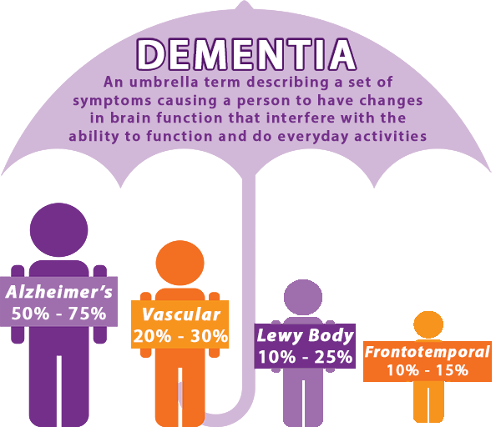
What is Dementia?
Notes:
So we all have heard the term “Dementia” but what is Dementia?! Dementia is an umbrella term used to describe a range of progressive neurological disorders. Under the Dementia Umbrella are: Alzheimer’s Disease, Vascular Dementia, Lewy Body Dementia and FrontoTemporal Dementia.
AD- it is still unknown what exactly causes it but the most distinguishing feature is the build of amyloid plaques and tau tangles.
VD- is caused by bleeding within the brain from a stroke which causes brain damage.
LBD- is caused by abnormal proteins called “Lewy Body” that somehow appear in nerve cells and impair functioning.
FTD- is when the frontal or temporal lobes of the brain are damaged or shrink. This type of dementia is usually inherited.

Slide 4
Alzheimer's disease
Alzheimer's is a type of dementia that affects memory, thinking and behavior. Symptoms eventually grow severe enough to interfere with daily tasks
Brain Changes
Happen 10-20 years before any symptoms present
Notes:
In order to understand Alzheimer’s and some of the mechanisms of drugs currently being study it is important to know that there are 2 types of abnormal structures that are the prime suspects in damaging and killing nerve cells, those are “ PLAQUES AND TANGLES”
.

Slide 5
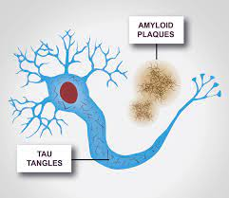
Understanding Brain Changes
We all have proteins in our body called BETA AMYLOID, what happens in people with Alzheimer’s are these beta amyloids proteins become abnormal and form these sticky PLAQUES that attach to neurons and affect cognition.
Another feature of Alzheimer’s are TAU TANGLES. Tau is a protein that when normal functions as the skeleton for neurons. But in Alzheimer’s disease these tau proteins become abnormal and form tangles inside the neurons which also affects cognition

Slide 6
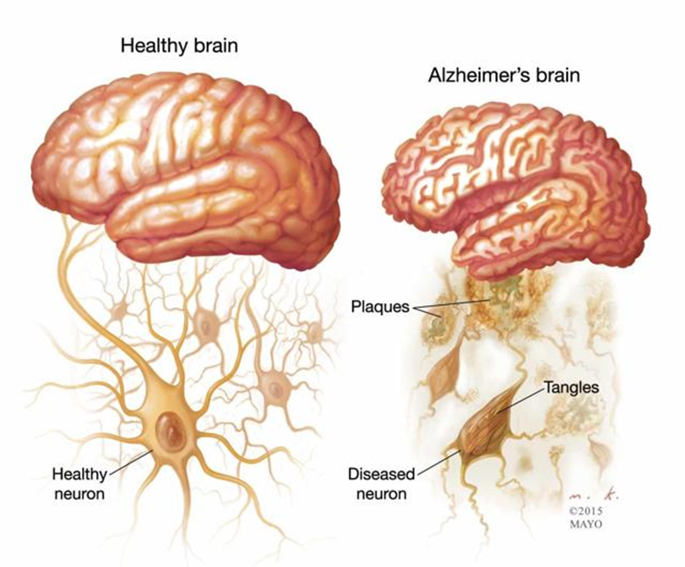
Let’s take a look…

Slide 7
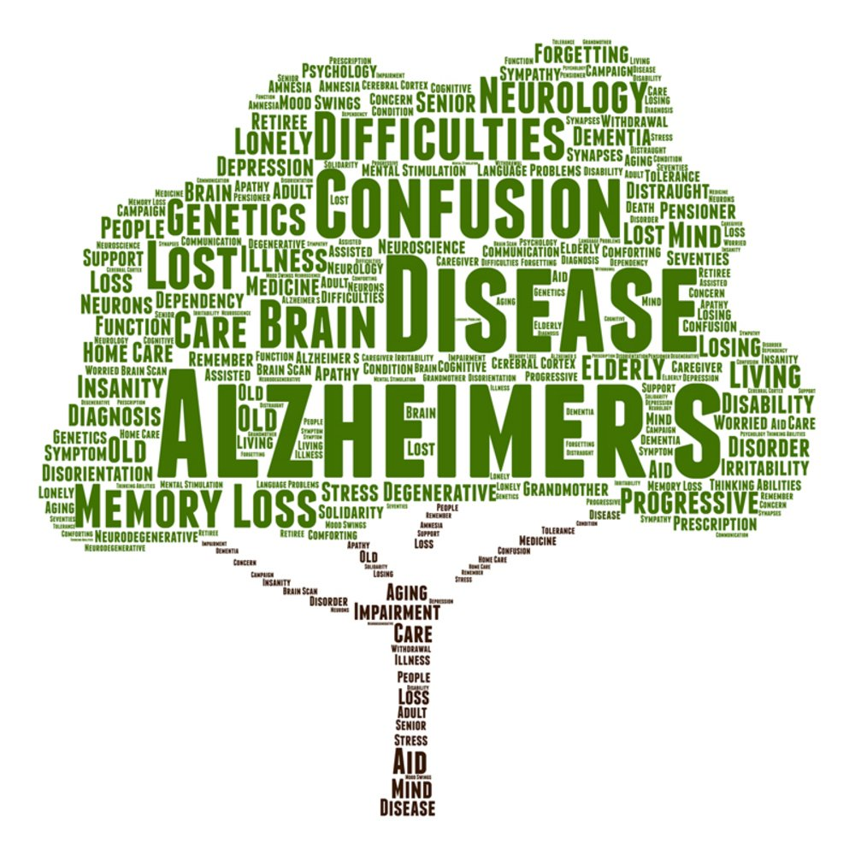
ALZHEIMER’S DEMENTIA
Facts
Symptoms
50-75% of all dementia cases
6th leading cause of death in the United States
Irreversible and progressive brain disorder that slowly destroys memory and thinking skills
Approximately 200,000 Americans under the age of 65 have younger-onset Alzheimer’s disease
Difficulty remembering newly learned information
Mood behavior changes
Deepening confusion about events, time and place
Unfounded suspicions about family, friends and professional caregivers
Difficulty speaking, swallowing and walking

Slide 8
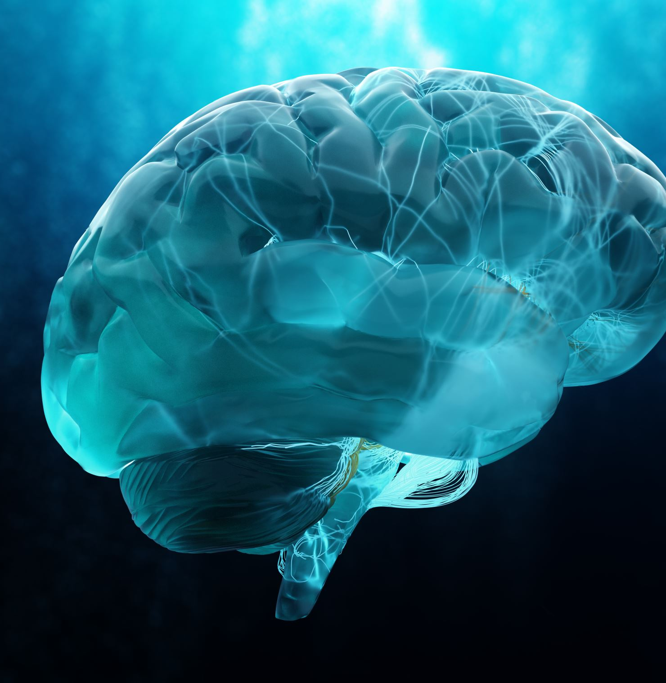
Current & Future Treatments
Currently- There is no cure for Dementia.
Treatment options focus on symptoms only
Monoclonal antibodies are currently under investigation and may help immune cells learn to target and clean up the damaging proteins in the brain.
Notes:
Treatment for dementia focus on symptom relief. In the case of the most progressive dementias, including Alzheimer's Disease, there is no cure. Ultimately, the path to effective new treatments for Dementia is through increased research participation in clinical studies.

Slide 9
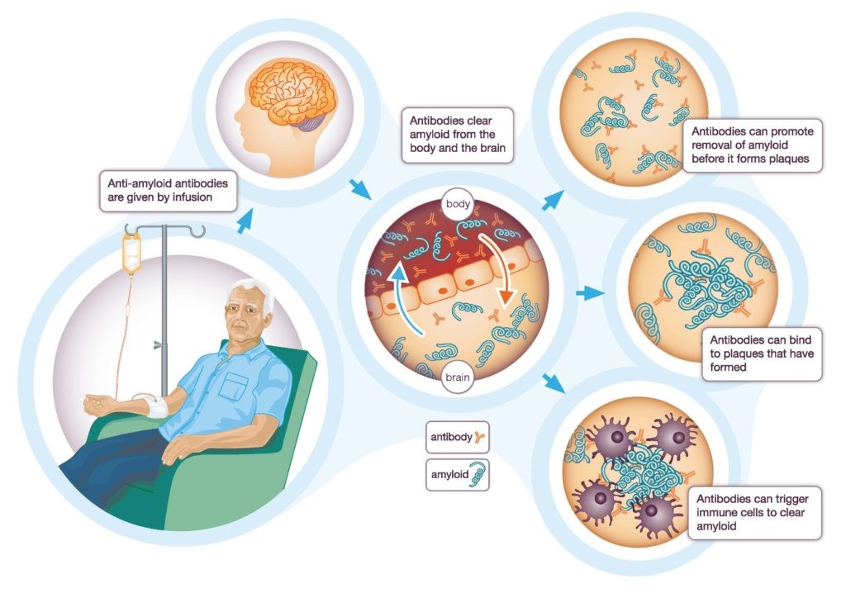
Current Research Breakthrough
Monoclonal Antibody
Aducanumab
Donanemab
Lecanemab
Notes:
Some current research studies are using therapies called MONOCLONAL ANTIBODIES. How monoclonal antibodies work in patients with Alzheimer’s Disease is they target and remove deposited amyloid plaque from the body. Removal of amyloid plaque could result in slowing of Alzheimer’s Disease Progression. How we measure changes in Amyloid Plaques is through pet scans of the brain.
In recent news ADUCANUMAB was approved by the FDA using their accelerated approval pathway for treatment in patients with Alzheimer's’ Disease. This is a great accomplishment and good new for the Alzheimer's community.

Slide 10
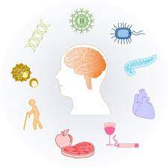
Who is at Risk?
Are you over the age of 65?
Are you a female?
Do you have a parent diagnosed with late-onset Alzheimer’s disease?
Do you have high blood pressure, high cholesterol or diabetes types 2?
Do you exercise and keep a healthy diet?
Do you carry the e4 variant in the APOE gene?
Notes:
There are several factors that put an individual at a higher risk of developing some type of dementia including Alzheimer’s Disease.

Slide 11
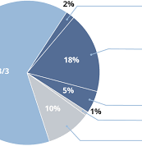
APOE GENE
Apolipoprotein E-
This protein helps control the levels of cholesterol and fats in the blood and is the most common genetic factor associated with late-onset Alzheimer’s disease.
There at least three slightly different versions of the APOE gene. The major versions are e2, e3 and e4.
The most common is e3 which is found in more than half of the general population.
The e4 version of the APOE gene increases an individual’s risk for developing late-onset Alzheimer’s disease and only about 5% of the population carry this version.
Notes:
It is important to highlight that not because you carry an apoe status 4/4 means that you will 100% develop Alzheimer’s Disease, it only means that you are a higher risk compared to the rest of the population.

Slide 12
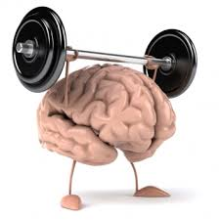
Lifestyle and Prevention
Notes:
Genetics play a big role when it comes to placing people on a high risk of developing some of the Dementia types. However, lifestyle is a also an important fact that needs to be addressed. Many experts believe that exercising your brain, eating a healthy diet in combination with physical activity can aid in the delay of normal aging memory loss.

Slide 13
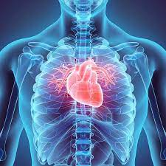
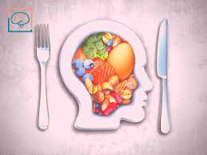
Let’s reduce the risk……..
Look after your heart!
Be Physically Active!
Follow a healthy Diet!
Challenge your brain!
Engage in social activity!

Slide 14
Other Types of Dementia

Slide 15
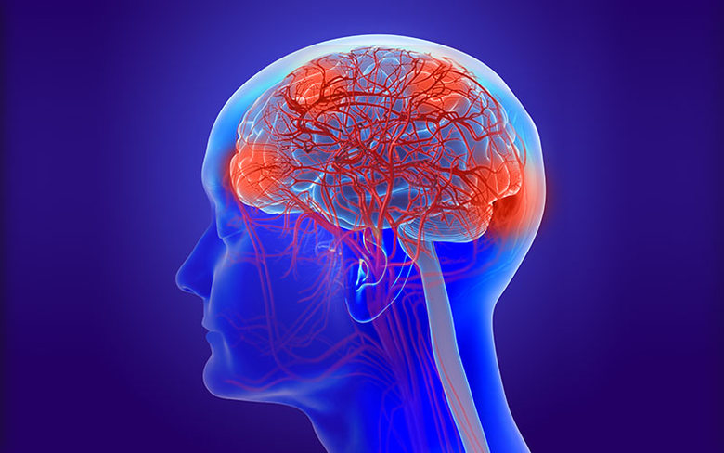
Symptoms
Often obvious soon after a major stroke
Changes in thinking and perception
Confusion, disorientation, trouble speaking or understanding speech
Difficulty walking, poor balance
VASCULAR DEMENTIA
FACTS
20-30% of dementia cases
Consider the 2nd most common cause of dementia after Alzheimer’s
Caused by conditions that block or reduce blood flow to various regions of the brain, depriving them of oxygen and nutrients

Slide 16
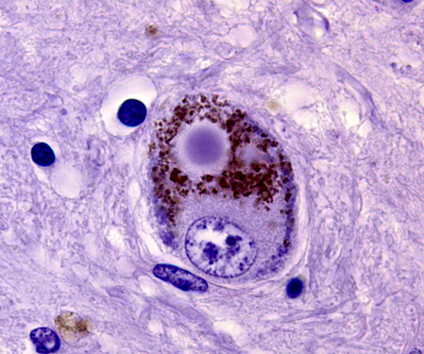
FACTS
10-25% of dementia cases
Associated with abnormal deposits of a protein known as a Lewy Bodies that affect chemicals in the brain that can lead to problems with thinking, movement, behavior and mood
Often confused with schizophrenia
LEWY BODY DEMENTIA
SYTMPOMS
Changes in thinking and reasoning
Confusion and alertness that varies significantly from one day to the next
Slowness, gait imbalance and other parkinsonian movement features
Well formed visual hallucinations and delusions
Sleep disturbances

Slide 17
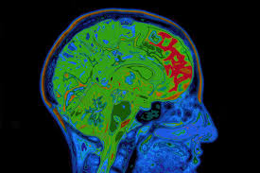
SYMPTOMS
Behavioral and Language changes
Disinhibition, apathy, compulsive behavior
Loss of word memory
Comprehension and grammar
FACTS
10-15% of dementia cases
FT degenerations are inherited in about a third of all cases
Degenerations refers to a group of disorders caused by progressive nerve cell loss in the brain’s frontal lobes or its temporal lobes
FRONTOTEMPORAL
DEMENTIA

Slide 18
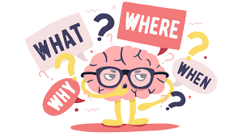
THANK YOU!

