Slide 1
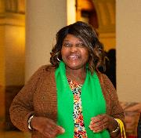
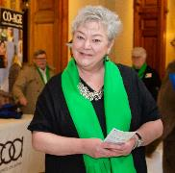
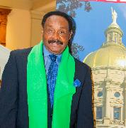
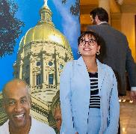
Notes:
Welcome to Engage with CO-AGE 2023! This year’s theme is “Your Role in Our Collective Advocacy.” Whether you are on the front lines or behind the scenes, your advocacy helps complete the picture. Throughout the presentation, you will see photos of actual CO-AGE members in action as a reminder that we can’t do what we do without you.

Slide 2
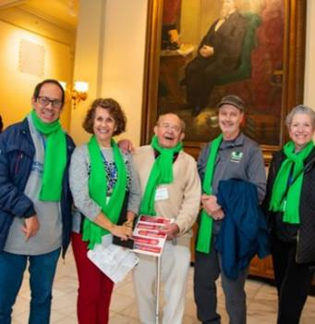
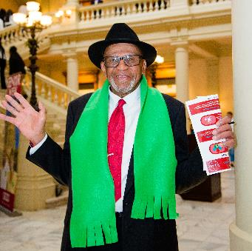
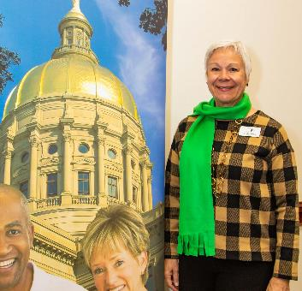
Agenda
About CO-AGE
CO-AGE Calendar
How CO-AGE Gets Bills Passed
Call for Issues
2024 CO-AGE Priorities
Ways to Get Involved
Notes:
Here is a glance at today’s agenda. As we engage with CO-AGE we want to make sure that everyone is clear on who we are and what we do. Before it’s revealed on the next slide, does anyone know off the top of your head what CO-AGE stands for?

Slide 3
About CO-AGE
Georgia Council on Aging
Created by the General Assembly in 1977 to advise state government on aging issues in Georgia
Coalition of Advocates for Georgia's Elderly (CO-AGE)
Created by the Council as a forum to identify and address concerns of older Georgians
As a high school student, Mirjam’s interest in American Sign Language sparked her desire to study communication, which led to her focus on technology and how it enhances communication.
Notes:
CO-AGE's story starts with the Georgia Council on Aging. It was created in 1977 by the Georgia General Assembly to advise state government leaders on aging issues. The Council is comprised of twenty Council members supported by three staff members. Shortly after its establishment, the Council created the Coalition of Advocates for Georgia’s Elderly (also known as CO-AGE) as a forum to identify and address concerns of older Georgians. Once those concerns are identified, CO-AGE members submit and vote on ideas for issues, which become the CO-AGE priorities that are presented to the legislators at the Capitol each year. You’ll hear more about this process later. Anyone who has a desire to improve the lives of older Georgians is welcome to become a CO-AGE member.

Slide 4
CO-AGE Calendar
April
May
June
Aug
July
Sept-Dec
Launch Contoso
Procure investments
Start development
Feb 20XX
Oct 20XX
Nov 20XX
January
April
20XX
20XX
Legislative Session:
Request funding
Hire designers
Open offices
May 20XX
Feb 20XX
Jul 20XX
Notes:
The month of April kicks off a new cycle of the CO-AGE calendar year. You may have seen the announcement for the Call for 2024 Issues that went out on April 3rd. Issues will be accepted up until May 5th. From May through June, issue submissions are reviewed by the council and finalized for the priority ballot. At the end of July, CO-AGE members vote on the priorities. In August the priorities with the highest votes are announced and from September to December, work groups meet. Each issue gets its own work group which meets once a month to really flesh out the problem, strategize, and come up with solutions that will later be presented to legislators for consideration. Starting fresh in January, a new Legislative Session starts and for a period of 40 legislative days, usually lasting up until April, legislators are at the Capitol hearing and discussing the concerns of Georgia residents and voting on bills to become law.

Slide 5
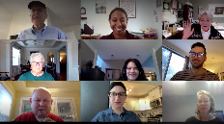
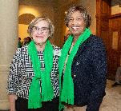
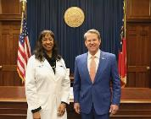
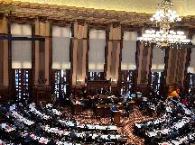
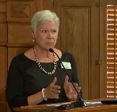
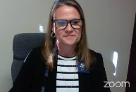
How CO-AGE Gets Bills Passed
Convene Work Groups
Meet with Legislators
Recruit Bill Sponsors
Floor Vote
Repeat Process in Other Chamber
Governor Signs
Testify in Committee
Notes:
Here you’ll see a map of the process. After the work groups wrap up and the Legislative Session starts, CO-AGE is represented at the Capitol by a combination of GCOA staff, Council members, CO-AGE members, and advocacy partners. Strategies include going to the Capitol to meet with legislators in their offices or at the ropes, sending them emails, attending advocacy days at the Capitol like Senior Day and attending committee meetings where legislators discuss and debate proposed bills. During the committee meetings CO-AGE often provides testimonies to support our position or requests. This is a time when your personal stories can really make an impact on legislators. We’ll hear some of those testimonies a little later. Once a bill is passed through committees and gets the full approval of the House or Senate, the process is repeated in the other Chamber. If it is successful, it will then be sent to the Governor to be signed into law.

Slide 6
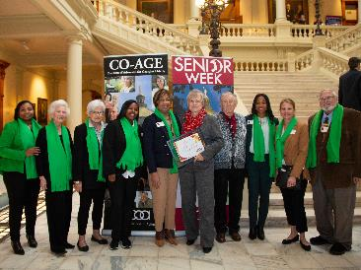
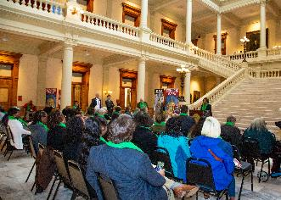
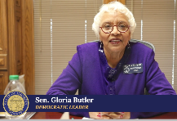
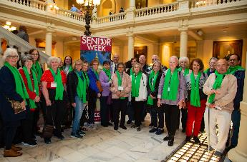
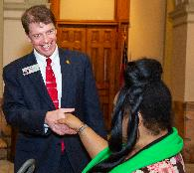
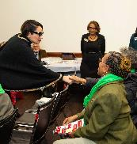
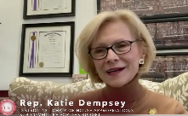
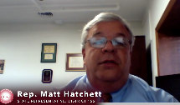
Senior Week 2023 (Senior Day at the Capitol (In-person) and the Senior Week Webinar (Online)
Mirjam is the CEO of Contoso to connect with each other all over the world. Mirjam's background as a PhD in communication theory led her to the idea for Contoso, and the building of a successful product for the tech industry.
Notes:
Every February, Senior Week at the Capitol is a key time for CO-AGE members to connect with legislators. By a show of hands, how many of you participated either in-person or virtually this year? Around 150 people attended Senior Day at the Capitol and over 20 legislators participated. The Distinguished Older Georgian, Carolyn Lipscomb was recognized, and members of the Aging network enjoyed the opportunity to come together. The Senior Week webinar was posted the day after Senior Day at the Capitol. There were appearances by the Governor and several legislators in addition to messages from the Georgia Council on Aging. It is still available for streaming on GCOA’s website.

Slide 7
2024 Call for Issues
Affects Seniors
Is a state-wide issue
Can be solved with legislation
Submit your issue in April 2024!
Notes:
For the 2024 Call for Issues, do you know of an issue that affects seniors, is a statewide issue and is solvable by legislative changes? Submit your issue today and let your voice be heard. I have some submission forms here for your convenience. I have a sample submission form for anyone who would like to see it. Does anyone have an issue that you’d like to share?

Slide 8
2024 CO-AGE Priorities
1
How do you define communication?
2
Do you think technology has helped or hindered our ability to communicate with each other?
3
Share your answers with each other.
Notes:
For the 2023 Legislative Session, CO-AGE took 4 priorities to the Capitol: Funding for Home and Community Based Services, Improvements to Assisted Living Communities, Teledentistry to reach underserved seniors, and the Work and Save program for those who do not have access to a traditional retirement plan with their employer.

Slide 9
Work Groups
Once the priorities are selected, a monthly work group is created for each issue to flesh them out, collect all the necessary data and information, and ultimately determine the best strategies to bring about change. Meetings are held via Zoom and last for an hour. CO-AGE issue work groups are critical to the success of our advocacy efforts as we prepare for the upcoming legislative session.
The October Work Group schedule is as follows:
​Medical Aid in Dying (MAID) Work Group- Tuesday, 11/14/2023 at 1pm
Home and Community Based Services (HCBS) Work Group- Thursday, 11/16/2023 at 10am
Multidisciplinary Teams for Adult Abuse, Neglect & Exploitation Work Group- Thursday, 11/16/2023 at 1pm

Slide 10
Join CO-AGE Today
Individual Membership- $10 (1 Vote)
Senior Center Membership- $50 (5 Votes)
Organizational Membership- $100 (7 Votes)
Notes:
Join CO-AGE Today! There are several levels of membership. Non-voting, Individual membership, Senior Center membership and Organizational membership. The paid membership options give you the power to submit and vote on the priorities that we take to the Capitol. You can join online at gcoa.org or by filling out a hard copy form.

Slide 11
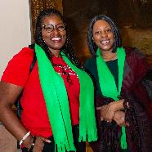
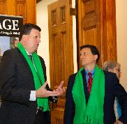
Advocate (noun) 1) One who defends or maintains a cause 2) One who supports or promotes the interests of a cause or group 3) One who pleads the cause of another 4) You
Notes:
Webster’s dictionary defines an advocate as:
1) One who defends or maintains a cause 2) One who supports or promotes the interests of a cause or group and 3) One who pleads the cause of another.
But- we’ve added one more definition- You!
We hope that this presentation helped you to see yourself as an advocate.

Slide 12
Thank you
Contact GCOA:
www.gcoa.org
Follow GCOA:
Notes:
Thank you for taking the time to Engage with CO-AGE. If you have any questions that were not answered today or if you would like to get in contact with the Georgia Council on Aging, you can reach them on their website at gcoa.org, Facebook, Instagram, Twitter or LinkedIn.

