Slide 1
Racial Disparities in Alzheimer’s Disease: how we can tackle this public health crisis and empower our communities to optimize brain health
Deborah Rose, MD
Department of Neurology
October 14, 2023

Slide 2

Inspiration for this work

Slide 3
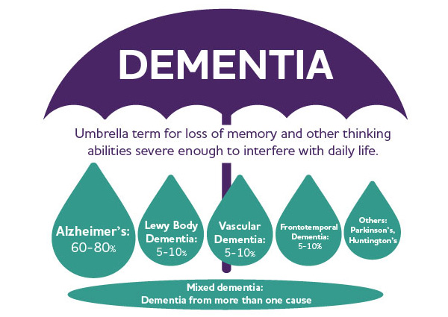
What is dementia?
Difficulty with memory, thinking, and decision-making that may interfere with one’s day-to-day functioning
Decline in cognitive abilities can also affect behavior, emotions and relationships
Can be caused by multiple conditions

Slide 4
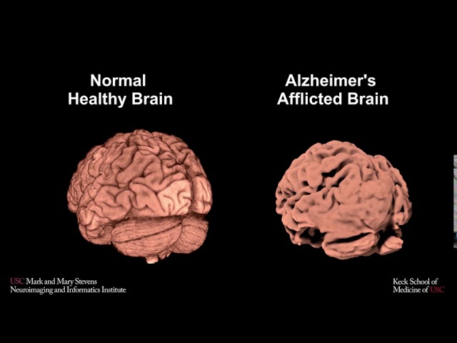
Background
Alzheimer’s disease (AD) is the most common cause of dementia
  Worldwide: >55 million¹
  US: 6.5 million²
In 2050, the number of patients diagnosed with AD will reach almost 14 million.
1. Gauthier S, Rosa-Neto P, Morais J, Webster C. World Alzheimer Report 2021: Journey through the diagnosis of dementia. Alzheimer’s Dis Int. Published online 2021:1-314.
2. Alzheimer’s Association. (2023). 2023 Alzheimer’s Disease Facts & Figures. Alzheimer’s & Dementia Journal, 19(4).

Slide 5
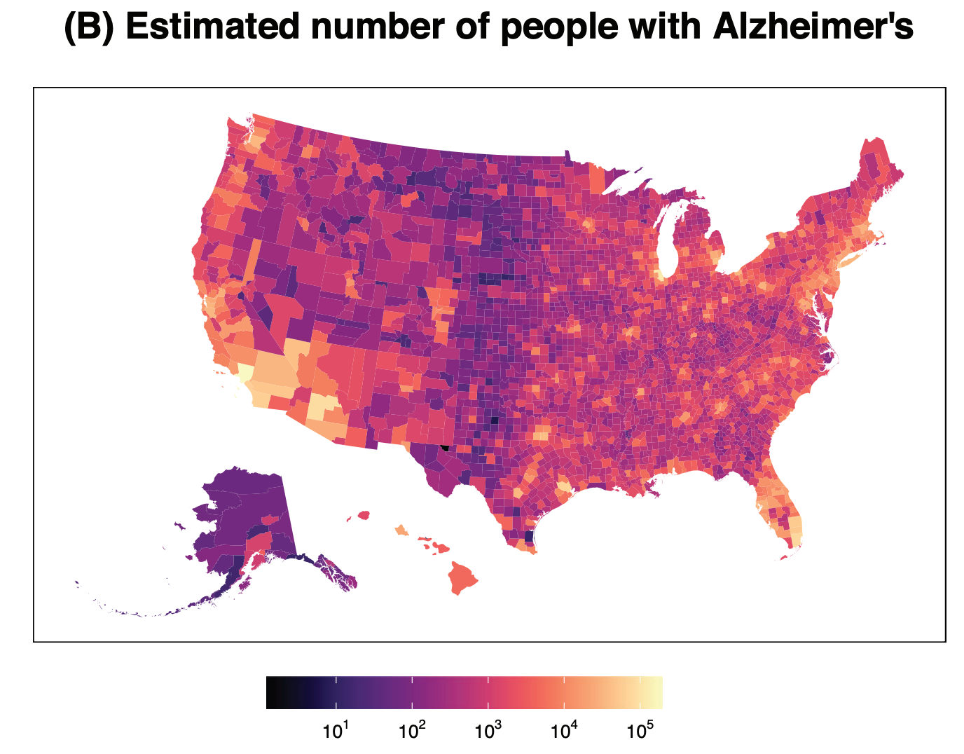
Background
Georgia is one of the top 10 states with the highest number of people living with dementia (N=~1,574,700)³
Counties with the highest prevalence of AD:
  Miami-Dade County, Fla. (16.6%)
  Baltimore City, MD. (16.6%)
  Bronx County, N.Y. (16.6%)
  Prince George’s County, MD (16.1%)
  Hinds County, Mississippi (15.5%)
  Orleans Parish, LA. (15.4%)
  Dougherty County, GA. (15.3%)
  Orangeburg County, S.C. (15.2%)
  Imperial County, Calif. (15.0%)
  El Paso County, Texas (15.0%)
3. Dhana, K., Beck, T., Desai, P., Wilson, R. S., Evans, D. A., & Rajan, K. B. (2023). Prevalence of Alzheimer’s disease dementia in the 50 US states and 3142 counties: A population estimate using the 2020 bridged-race postcensal from the National Center for Health Statistics. Alzheimer’s & Dementia : The Journal of the Alzheimer’s Association.

Slide 6
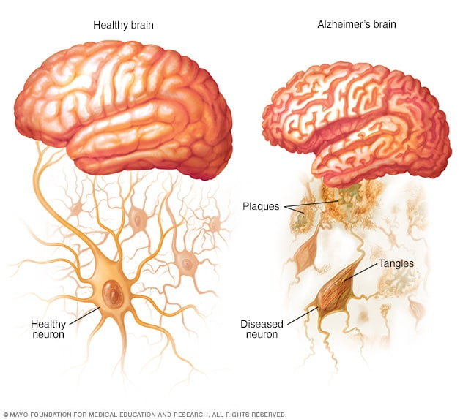
Alzheimer’s Disease

Slide 7
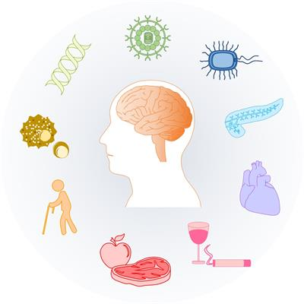
Risk factors for Alzheimer’s disease
Age
Low educational attainment
Head injury
Depression
Cardiovascular
Social isolation
Family history
Stress / Environmental factors

Slide 8

Populations at higher risk
Racial and ethnic minoritized groups, including African Americans and Latinos, are more likely to develop AD compared to whites (2x and 1.5x)²
Women are more likely than men to develop the disease. An estimated 3.8 million American women are living with the disease today²
2. Alzheimer’s Association. (2023). 2023 Alzheimer’s Disease Facts & Figures. Alzheimer’s & Dementia Journal, 19(4).

Slide 9
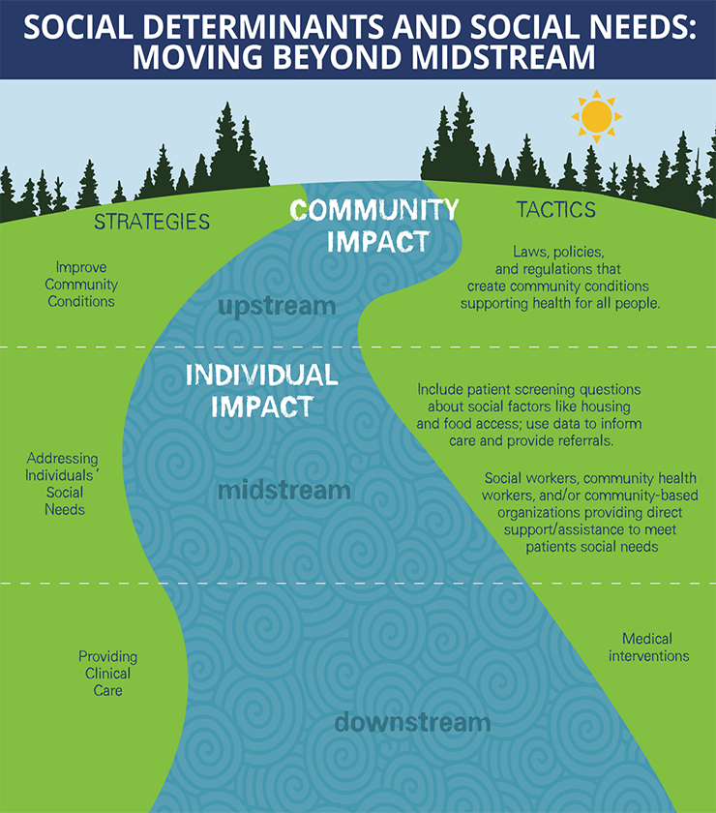
Racial disparities in cognitive aging
Socioeconomic status
Cardiovascular disease
Structural factors
Early life adversity / childhood trauma

Slide 10

Warning Signs of Dementia
Memory loss that disrupts daily life
Challenges in planning or solving problems
Difficulty with completing familiar everyday tasks
Decreased or poor judgment
Withdrawal from work or social activities
Changes in mood and personality

Slide 11

Early detection
Approaching your loved one
Seeing a clinician
Benefits of early detection

Slide 12

Participation in Clinical Trials
Clinical trial – research that studies new tests and treatments to evaluate their impact on human health outcomes
Importance of diversity
  Improve generalizability
  Reduce health inequalities
Community engagement
  Building trust
  Cultural and linguistic sensitivity
  Sustained exposure to professionals

Slide 13






Optimizing Brain Health
Exercise
Sleep
Diet (vegetables, nuts, berries, beans)
Quit smoking
Go to your doctor for regular check-ups
Cognitive stimulation
Social interaction (volunteering, special-interest club, tour at the museum, etc)

Slide 14
Thank You

